Slide 1
Smart Grid Stability Prediction using Deep Learning
By
Ratnadeep Das Choudhury (19BEE1125)
Souvik Datta (19BEE1213)

Slide 2
Objectives
Accurate planning for both energy production and consumption disturbances.
Examining consumer response to economic changes
Studying system fluctuations dynamically.

Slide 3
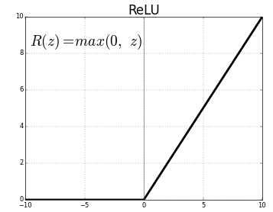
Methodology
The artificial neural network (ANN) architecture will contain a sequential model constructed in the following way -
One input layer (12 input nodes)
Three hidden layers (24, 24 and 12 nodes)
One single-node output layer.
'ReLU' as the activation function for hidden layers.
‘Sigmoid' as activation function for the output layer.

Slide 4
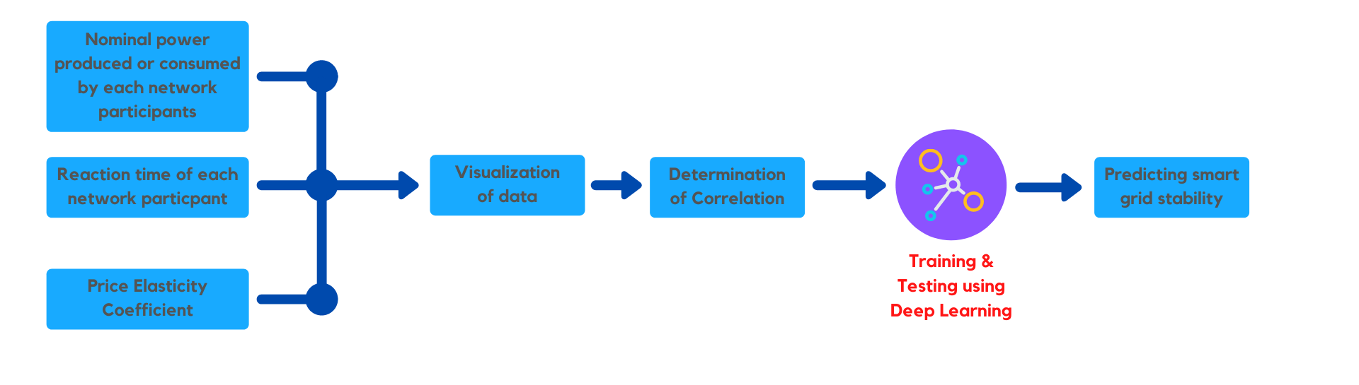
Block Diagram

Slide 5
Timeline & Planning
Gathering Resources and Datasets - By Review - 1
Write the code for visualization - Post Review - 1
Training the Deep Learning model using Jupyter Notebook - Post Review - 2
Predicting Smart Grid Stability using Deep Learning results - By Review - 3

Slide 6
References
Breviglieri, P., Erdem, T., & Eken, S. (2021). Predicting Smart Grid Stability with Optimized Deep Models. SN Computer Science, 2(2). doi:10.1007/s42979-021-00463-5
Azad, S., Sabrina, F., & Wasimi, S. (2019, November). Transformation of smart grid using machine learning. In 2019 29th Australasian Universities Power Engineering Conference (AUPEC) (pp. 1-6). IEEE.
Omitaomu, O. A., & Niu, H. (2021). Artificial intelligence techniques in smart grid: A survey. Smart Cities, 4(2), 548-568.

